Slide 2
Object Character Recognition in R Using Tesseract

Slide 3
Who am I?
What is Object Character Recognition (OCR)?
What is Tesseract?
How does it work?
Using Tesseract in R
Some Examples

Slide 4
Outline
What is Object Character Recognition (OCR)?
What is Tesseract?
How does it work?
Using Tesseract in R
Some Examples

Slide 5
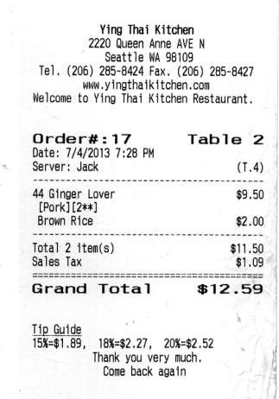
What is Optical Character Recognition
conversion of images of typed, handwritten or printed text into machine-encoded text,
Receipt
Digitized Text
Ying Thai Kitchen
2220 Queen Anne AVE N
Seattle WA 98109
Tel. (206) 285-8424 Fax. (206) 285-8427
www. yingthaikitchen.com
Welcome to Ying Thai Kitchen Restaurant,
Order#:17 Table 2
Date: 7/4/2013 7:28 PM
~ Server: Jack (T.4)
44 Ginger Lover $9.50
[Pork] [2**]
Brown Rice $2.00
Total 2 item(s) $11.50
Sales Tax $1.09
Grand Total $12.59
Tip Guide
15%=$1.89, 18%=$2.27, 20%=$2.52 ,
Thank you very much.
Come back again
OCR

Slide 6
What is Optical Character Recognition
conversion of images of typed, handwritten or printed text into machine-encoded text,
Check
Digitized Text
Ying Thai Kitchen
2220 Queen Anne AVE N
Seattle WA 98109
Tel. (206) 285-8424 Fax. (206) 285-8427
www. yingthaikitchen.com
Welcome to Ying Thai Kitchen Restaurant,
Order#:17 Table 2
Date: 7/4/2013 7:28 PM
~ Server: Jack (T.4)
44 Ginger Lover $9.50
[Pork] [2**]
Brown Rice $2.00
Total 2 item(s) $11.50
Sales Tax $1.09
Grand Total $12.59
Tip Guide
15%=$1.89, 18%=$2.27, 20%=$2.52 ,
Thank you very much.
Come back again
OCR

Slide 7

What is Tesseract
A Brief History
OCR engine developed from 1984-1994 with HP Labs
1995 UNLV OCR Contest
2005 HP released Tesseract to the public
2006 Google sponsored it
2007+ 116 new languages added
Ray Smith
Sr. Staff Engineer, Google
Notes:
Tesseract is an OCR engineer developed between 1984 and 1994 as part of a phd thesis for Dr. Ray Smith while being apart of HP labs. He then went up to further develop the algorithm with HP labs. (just a side note, Ray Smith now works at google and is considered one of the worlds leading experts in OCR).
Its initial use was going to be in scanners to turn scanned documents into digitized documents. For whatever reason they never implemented it and some years later they decided to enter it into this OCR competition at UNLV. It ended up performing really well and then it just disappeared for 10 years until HP released it in 2005. During this time I am sure it was implemented for OCR projects but I do not know the details.
Then in 2006 google decided to sponsor the open source software and asked Ray smith to come work them and he has been there ever since.
Since then the software has been continued to be developed into tons of languages including right to left languages like Arabic or Hebrew

Slide 8
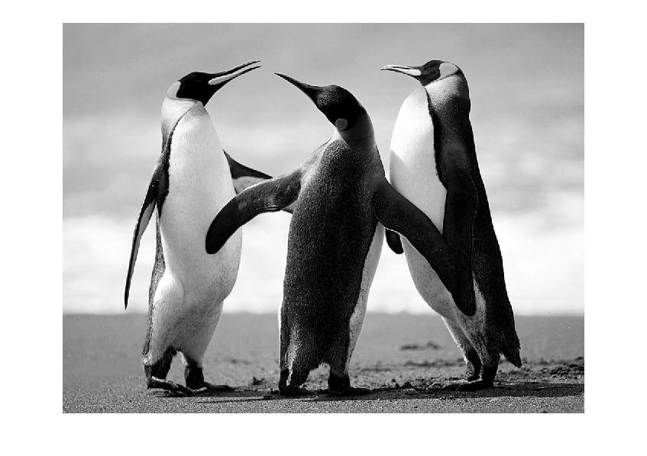
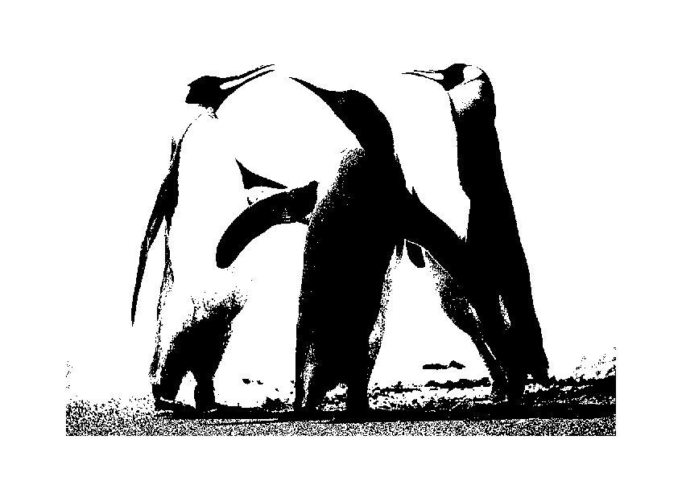
What is a Binary Image?
Some Terminology
a digital image that has only two possible values for each pixel
gray scale image
binary image
Notes:
So we need to get through some terminology before I go through the algorithm. First, a binary image is a digital image that can only have two possible values for each pixel. Here I took a grey scale image of some penguins and I converted it to binary. Usually the two pixels are black and white.

Slide 9
What is a Blob?
Some Terminology
Blob (Connected Component)
is a connected piece in a binary image
0 | 0 | 0 | 0 | 0 | 0 | 0 | 0 | 0 | 0
0 | 1 | 1 | 1 | 0 | 0 | 1 | 0 | 0 | 0
0 | 0 | 1 | 1 | 1 | 1 | 0 | 0 | 1 | 1
0 | 0 | 1 | 1 | 0 | 1 | 1 | 0 | 1 | 1
0 | 0 | 0 | 0 | 0 | 0 | 0 | 0 | 0 | 0
0 | 1 | 0 | 1 | 0 | 0 | 1 | 0 | 1 | 0
0 | 1 | 1 | 1 | 0 | 0 | 0 | 1 | 0 | 0
0 | 0 | 0 | 0 | 0 | 0 | 0 | 0 | 0 | 0
Notes:
So for example, just image has four blobs

Slide 10
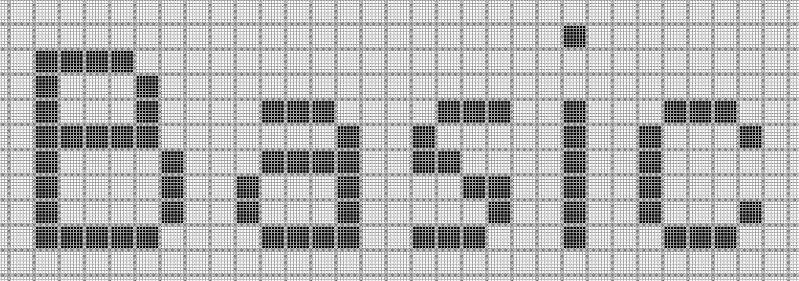
What is a Blob?
Some Terminology
Blob (Connected Component)
is a connected piece in a binary image
Notes:
This image has five blobs. Hopefully in this image you can see how breaking down images into binary and blogs can be valuable extracting text information.

Slide 11
Tesseract: How does it work?
Introduction
Ensemble of multiple algorithms
9 major algorithm steps
Blob filtering and line construction are key parts of this process.
Notes:
So, Tesseract us an ensemble of 9 major steps which consists of a series of algorithms. I am not going to go into great detail but I wanted to give you all an idea of how it works.
Binary image – pixels can only be two possible values (usually black/white).

Slide 12
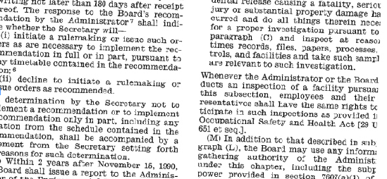
Finding the best match (continued)
Example from Adobe.com
Notes:
Outlines what is a text and turns them into blobs
Turns blobs into what it thinks are blob-lines
Breaks blobs-lines into blob-words (by character spacing)
Chops blob-words into blob-characters (uses median text width/ proportional size/ spaces/ fuzzy spaces)
Recognition proceeds as a two-pass process.
First pass – attempts to recognize word
If satisfactory – goes to adaptive classifier as training data
As a result the adaptive classifier gets a chance at improving results among text lower down on the page.
To use this data, a second pass is done during which words not classified the first time are classified again

Slide 13
Finding the best match (continued)
Input: binary image
Outlines what is a text and turns them into blobs
Notes:
Outlines what is a text and turns them into blobs
Turns blobs into what it thinks are blob-lines
Breaks blobs-lines into blob-words (by character spacing)
Chops blob-words into blob-characters (uses median text width/ proportional size/ spaces/ fuzzy spaces)
Recognition proceeds as a two-pass process.
First pass – attempts to recognize word
If satisfactory – goes to adaptive classifier as training data
As a result the adaptive classifier gets a chance at improving results among text lower down on the page.
To use this data, a second pass is done during which words not classified the first time are classified again

Slide 14
Finding the best match (continued)
Outlines what is a text and turns them into blobs
Turns blobs into what it thinks are blob-lines
Notes:
Outlines what is a text and turns them into blobs
Turns blobs into what it thinks are blob-lines
Breaks blobs-lines into blob-words (by character spacing)
Chops blob-words into blob-characters (uses median text width/ proportional size/ spaces/ fuzzy spaces)
Recognition proceeds as a two-pass process.
First pass – attempts to recognize word
If satisfactory – goes to adaptive classifier as training data
As a result the adaptive classifier gets a chance at improving results among text lower down on the page.
To use this data, a second pass is done during which words not classified the first time are classified again

Slide 15
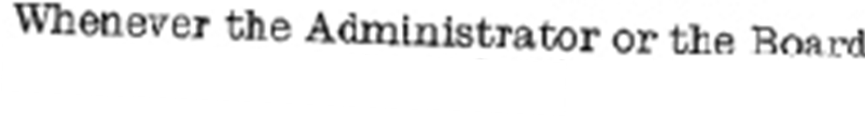
Finding the best match (continued)
Outlines what is a text and turns them into blobs
Turns blobs into what it thinks are blob-lines
Breaks blobs-lines into blob-words (by character spacing)
Notes:
Outlines what is a text and turns them into blobs
Turns blobs into what it thinks are blob-lines
Breaks blobs-lines into blob-words (by character spacing)
Chops blob-words into blob-characters (uses median text width/ proportional size/ spaces/ fuzzy spaces)
Recognition proceeds as a two-pass process.
First pass – attempts to recognize word
If satisfactory – goes to adaptive classifier as training data
As a result the adaptive classifier gets a chance at improving results among text lower down on the page.
To use this data, a second pass is done during which words not classified the first time are classified again

Slide 16
Finding the best match (continued)
Outlines what is a text and turns them into blobs
Turns blobs into what it thinks are blob-lines
Breaks blobs-lines into blob-words (by character spacing)
Chops blob-words into blob-characters
Notes:
Outlines what is a text and turns them into blobs
Turns blobs into what it thinks are blob-lines
Breaks blobs-lines into blob-words (by character spacing)
Chops blob-words into blob-characters (uses median text width/ proportional size/ spaces/ fuzzy spaces)
Recognition proceeds as a two-pass process.
First pass – attempts to recognize word
If satisfactory – goes to adaptive classifier as training data
As a result the adaptive classifier gets a chance at improving results among text lower down on the page.
To use this data, a second pass is done during which words not classified the first time are classified again

Slide 17
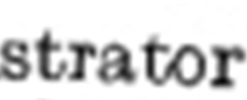
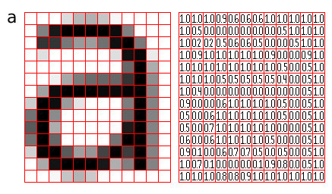
Finding the best match (continued)
Chops blob-words into blob-characters
Text recognition First pass (with training data)
Training Data
Notes:
The classifier is trained on a mere 20 samples of 94 characters from 8 fonts in a single size, but with 4 attributes (normal, bold, italic, bold italic), making the total of 60160 training samples.

Slide 18
Finding the best match (continued)
Chops blob-words into blob-characters
Text recognition First pass (with training data)
Training Data
Recognized word
Updated
Training Data
Notes:
It is my understanding that the classification measured as a “best” match of directly comparing the bit-map of the training letters to the bit-map of the text blob

Slide 19
Finding the best match (continued)
Chops blob-words into blob-characters
Text recognition First pass (with training data)
Training Data
Recognized word
Text recognition Second pass (with updated training data)
Updated
Training Data
Notes:
It is my understanding that the classification measured as a “best” match of directly comparing the bit-map of the training letters to the bit-map of the text blob

Slide 20
Finding the best match (continued)
Chops blob-words into blob-characters
Text recognition First pass (with training data)
Training Data
Recognized word
Text recognition Second pass (with updated training data)
Updated
Training Data
a d m i n i s t r a t o r
Is this a
real word?
Linguistic Analysis
Text output
Yes
Notes:
It is my understanding that the classification measured as a “best” match of directly comparing the bit-map of the training letters to the bit-map of the text blob

Slide 21
Tesseract Application in R

Slide 22
Algorithm in Detail

Slide 23
Tesseract: How does it work?
Introduction
Ensemble of multiple algorithms
9 major algorithm steps
Blob filtering and line construction are key parts of this process.
Notes:
So, Tesseract us an ensemble of 9 major steps which consists of a series of algorithms. I am not going to go into great detail but I wanted to give you all an idea of how it works.
Binary image – pixels can only be two possible values (usually black/white).

Slide 24
Tesseract: How does it work?
Introduction
Component Outlines In Text Regions
Character Outlines Organized Into Words
Character Outlines In Text Regions
Input: Binary Image
Page Layout Analysis
Blob Finding
Find Text Lines and Words
Recognize Word Pass 1
Character Associater
Character Chopper
Fuzzy Space & x-height Fix-up
Recognize Word Pass 2
Output: Text
Done?
Yes
Static
Character
Classifier
Dictionary
Adaptive
Character
Classifier
Number
Parser
Adapt to
Word

Slide 25
Line and Word Finding
Y
“
ou don't have to see the whole staircase. Just take the first step.” Martin Luther King
Notes:
1. Line Finding
Algorithm is designed so that skewed page can be recognized without having to deskew, thus preventing any loss of image quality.
Blob filtering and line construction are key parts of this process.
Under the assumption that most blobs have uniform text size, a simple percentile height filter removes drop-caps and vertically touching characters and median height approximates the text size in the region.
Blobs smaller than a certain fraction of the median height are filtered out, being most likely punctuation, diacritical marks and noise.
The filtered blobs are more likely to fit a model of non-overlapping, parallel, but sloping lines. Sorting and processing the blobs by x-coordinates makes it possible to assign blobs to a unique text line, while tracking the slope across the page.
Once the lines are assigned, a least median of squares fit is used to estimate the baselines, and filtered-out blobs are fitted back into appropriate lines.
Final step merges blobs that overlap by at least half horizontally, putting diacritical marks together with the correct base and correctly associating parts of some broken characters.

Slide 26
Line and Word Finding
Y
“
ou don't have to see the whole staircase. Just take the first step.” Martin Luther King
percentile height filter removes drop-caps and vertically touching characters
Median height of text calculated
Notes:
percentile height filter removes drop-caps and vertically touching characters

Slide 27
Line and Word Finding
Y
“
ou don't have to see the whole staircase. Just take the first step.” Martin Luther King
Blobs smaller than a certain fraction of the median height are filtered out (punctuation)
Notes:
Blobs smaller than a certain fraction of the median height are filtered out, being most likely punctuation, diacritical marks and noise.

Slide 28
Line and Word Finding
Y
“
ou don't have to see the whole staircase. Just take the first step.” Martin Luther King
track the blobs across the x-axis and look at the slope of each blob to detect what line they might be on
Notes:
Next they track the blobs across the x-axis and look at the slope of each blob to detect what line they might be on
There are some additional steps here, like using a median regression to try and estimate the baseline and add back in filtered out blobs

Slide 29
Estimating Blob Lines
Y
“
ou don't have to see the whole staircase. Just take the first step.” Martin Luther King
track the blobs across the x-axis and look at the slope of each blob to detect what line they might be on
Notes:
Next they track the blobs across the x-axis and look at the slope of each blob to detect what line they might be on
There are some additional steps here, like using a median regression to try and estimate the baseline and add back in filtered out blobs
Baseline fitting is done by partitioning the blobs into groups of reasonable continuous displacement for the original straight baseline

Slide 30
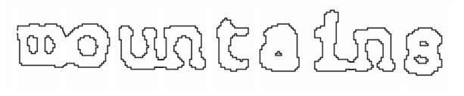
Fixed Pitch Detection and Chopping
Notes:
After all that, you have something that looks like this
A series of blobs that are possibly connected to one another and whether they are fixed pitch text (same width)
Looks at blobs and tried to estimate the width of the words and then chops it

Slide 31
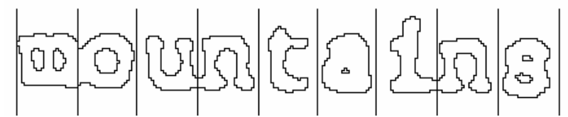
Fixed Pitch Detection and Chopping
Chopping words by estimated monotonic text width
Notes:
After all that, you have something that looks like this
A series of blobs that are possibly connected to one another and whether they are fixed pitch text (same width)
Looks at blobs and tried to estimate the width of the words and then chops it

Slide 32
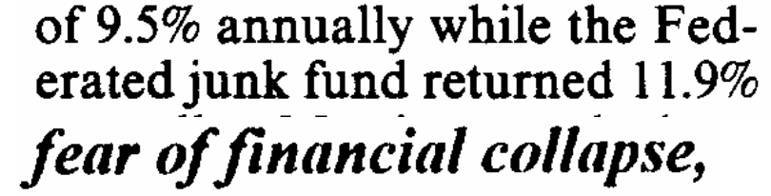
When Estimated Text Width Doesn’t work: Proportional Word finding
measuring gaps in a limited vertical range between baseline and mean line. Spaces close to a threshold are made fuzzy, where the decisions are made after word recognition.
Notes:
After all that, you have something that looks like this
A series of blobs that are possibly connected to one another and whether they are fixed pitch text (same width)
Looks at blobs and tried to estimate the width of the words and then chops it

Slide 33
When Estimated Text Width Doesn’t work: Proportional Word finding
No gap
measuring gaps in a limited vertical range between baseline and mean line. Spaces close to a threshold are made fuzzy, where the decisions are made after word recognition.
Notes:
You can see it is not easy to calculate due to the lack of gap for between of and financial

Slide 34
When Estimated Text Width Doesn’t work: Proportional Word finding
No gap
measuring gaps in a limited vertical range between baseline and mean line. Spaces close to a threshold are made fuzzy, where the decisions are made after word recognition.
Notes:
You can see it is not easy to calculate due to the lack of gap for between of and financial
The gap in between the 1 and the nine in 1.9% is much larger than in any of the works in “erated”
Just another reason to attempt word recognition PRIOR to

Slide 35
Word Recognition

Slide 36
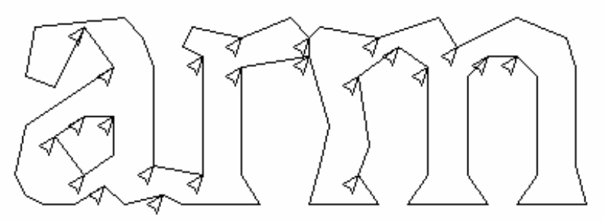
Chopping Joined Characters
Notes:
Tesseract attempts to improve the result by chopping the blob with worst confidence from the character classifier.
Chop points are found from concave vertices of a poligonal approximation of the outline.
It may take upto 3 pairs of chop points to successfully separate joined characters from ASCII set.
Any chop that fails to improve the confidence of the result is undone (but not discarded bc it could be re0used as an associator

Slide 37
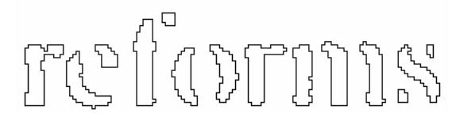
Associating Broken Characters
Notes:
After the potential chops have been exhausted, if the word is still not good enough, it is given to the associator, which makes a best first search of the segmentation graph of the possible combinations of the maximally chopped blobs into candidate characters.

Slide 38
Static Character Classifier

Slide 39
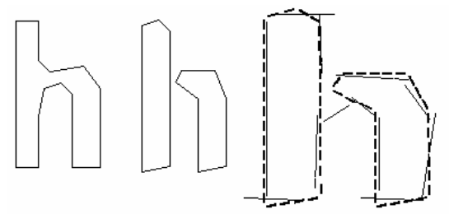
Features
Notes:
Another idea for classification involved use of segments of the polygonal approximation as features, but this method is also not robust to damaged characters.
During training, segments of a polygonal approximation are used for features, but during recognition, features of a small, fixed length are extracted from the outline and matched many-to-one against the clustered prototype features of the training data.
The process of small features matching large prototypes is easily able to cope with recognition of damaged words.

Slide 40
Classification
This stage proceeds as a two-step process. First step involves a class prunerthat creates a shortlist of character classes that the unknown might match.
The classes shortlisted in step one are taken further to the next step, where the actual similarity is calculated from the feature bit vectors. Each prototype character class is represented by a logical sum-of-product expression with each term called a configuration.

Slide 41
3. Training Data
The classifier is trained on a mere 20 samples of 94 characters from 8 fonts in a single size, but with 4 attributes (normal, bold, italic, bold italic), making the total of 60160 training samples.

Slide 42
1 Line Finding
Algorithm designed to read skewed pages
Assumptions that most blobs are uniform text size
Percentile high filter used to remove drop-caps and vertically touching characters
Median high used to approximate text size in region
Blobs smaller than a specific fraction of median height are filtered out (punctuation/ diacritical marks/ noise)
The filtered blobs are more likely to fit a model of non-overlapping, parallel, but sloping lines. Sorting and processing the blobs by x-coordinates makes it possible to assign blobs to a unique text line, while tracking the slope across the page.
Once the lines are assigned, a least median of squares fit is used to estimate the baselines, and filtered-out blobs are fitted back into appropriate lines.
Final step merges blobs that overlap by at least half horizontally, putting diacritical marks together with the correct base and correctly associating parts of some broken characters.
Notes:
1. Line Finding
Algorithm is designed so that skewed page can be recognized without having to deskew, thus preventing any loss of image quality.
Blob filtering and line construction are key parts of this process.
Under the assumption that most blobs have uniform text size, a simple percentile height filter removes drop-caps and vertically touching characters and median height approximates the text size in the region.
Blobs smaller than a certain fraction of the median height are filtered out, being most likely punctuation, diacritical marks and noise.
The filtered blobs are more likely to fit a model of non-overlapping, parallel, but sloping lines. Sorting and processing the blobs by x-coordinates makes it possible to assign blobs to a unique text line, while tracking the slope across the page.
Once the lines are assigned, a least median of squares fit is used to estimate the baselines, and filtered-out blobs are fitted back into appropriate lines.
Final step merges blobs that overlap by at least half horizontally, putting diacritical marks together with the correct base and correctly associating parts of some broken characters.

Slide 43
Tesseract: How does it work?
Outlines are analysed and stored
2. Outlines are gathered together as Blobs
3. Blobs are organized into text lines
4. Text lines are broken into words
5. First pass of recognition process attempts to recognize each word in turn
6. Satisfactory words passed to adaptive trainer
7. Lessons learned by adaptive trainer employed in a second pass, which attempts recognize the words that were not recognized satisfactorily in the first pass
8. Fuzzy spaces resolved and text checked for small caps
9. Digital texts are outputted

Slide 44
Outlines what is thinks are words and puts them into blobs
Blobs organized into text lines (analyzed for proportional text and fixed pitch)
Line are broken into words based on character spacing
Word blobs are then chopped by fixed pitch text
Proportion text broken into words using definite spaces or fuzzy spaces
Notes:
Outlines what is a text and turns them into blobs
Turns blobs into what it thinks are blob-lines
Breaks blobs-lines into blob-words (by character spacing)
Chops blob-words into blob-characters (uses median text width/ proportional size/ spaces/ fuzzy spaces)

Slide 45
Recognition proceeds as a two-pass process.
During the first pass, attempt is made to recognize each word.
The words that are satifactorily identified are passed to an adaptive classifier as training data.
As a result the adaptive classifier gets a chance at improving results among text lower down on the page.
In order to utilize the training of adaptive classifier on the text near the top of the page as second pass is performed, during which words that were not recognized well enough are classified again.
Final Phase resolves the fuzzy spaces, and checks alternative hypotheses for the x-height to locate small-cap text.
Notes:
Recognition proceeds as a two-pass process.
First pass – attempts to recognize word
If satisfactory – goes to adaptive classifier as training data
As a result the adaptive classifier gets a chance at improving results among text lower down on the page.
To use this data, a second pass is done during which words not classified the first time are classified again

